Slide 1
KUNGUMA DHARSHINI
Final Project
3/21/2024 Annual Review

Slide 2
IMAGE AUGMENTATION USING TENSOR FLOW
3/21/2024 Annual Review

Slide 3


AGENDA
Problem Statement
Problem Overview
End Users
Solution and Value Proposition
Wow Factor
Modeling for Image Augmentation using Tensor Flow
Result
3/21/2024 Annual Review

Slide 4

PROBLEM STATEMENT
Identifying the Challenge:
However, traditional methods for data augmentation often struggle to produce high-quality, diverse, and realistic synthetic images.
In computer vision tasks, the performance of machine learning models heavily relies on the quality and diversity of training data.
Consequences:
This limitation undermines the performance and generalization ability of models trained on augmented datasets, hampering their real-world applicability.
3/21/2024 Annual Review

Slide 5

PROJECT OVERVIEW Current Approaches: "Existing techniques for image augmentation rely on manual preprocessing or simple geometric transformations." Limitations: "These methods often fail to capture the complexity and variability of real-world images, resulting in suboptimal model performance." Consequences: "Models trained on such datasets may exhibit poor generalization and struggle to perform well in diverse environments."
3/21/2024 Annual Review

Slide 6

WHO ARE THE END USERS? Target Audience: Our solution targets researchers, developers, and companies seeking advanced image augmentation techniques for machine learning tasks. Addressing Their Needs: These end users require robust and efficient image augmentation solutions to enhance the diversity and quality of their training datasets. Solution Alignment: Our solution aligns with these needs by offering state-of-the-art generative AI techniques for image augmentation using Tensor Flow.
3/21/2024 Annual Review

Slide 7

YOUR SOLUTION AND ITS VALUE PROPOSITION Introducing the Solution: We present a novel approach for image augmentation using generative AI techniques powered by Tensor Flow. Key Features: Our solution offers unparalleled realism and diversity in synthetic image generation, enabling users to create high-quality training datasets. Value Proposition: By integrating our solution into their workflows, users can enhance the performance and generalization of their machine learning models, leading to improved accuracy and robustness.
3/21/2024 Annual Review

Slide 8

THE WOW IN YOUR SOLUTION
Innovation Highlight:
What sets our solution apart is its ability to produce highly realistic and diverse synthetic images using advanced generative AI techniques.
Unique Selling Points:
Our solution leverages Tensor Flow's capabilities to implement cutting-edge generative AI models, enabling users to augment their datasets with unprecedented fidelity and variability.
Demonstration:
Let's showcase some examples of synthetic images generated using our solution and compare them to real-world counterparts.
3/21/2024 Annual Review
8

Slide 9
MODELLING
Technical Overview:
Our solution is implemented using TensorFlow, a leading deep learning framework known for its scalability and efficiency.
Augmentation Techniques:
We employ state-of-the-art generative AI models, such as GANs and VAEs, to produce realistic and diverse synthetic images for augmentation.
Implementation Details:
Our solution leverages TensorFlow's rich set of APIs and tools for model development, training, and deployment.
Performance Evaluation:
Preliminary experiments demonstrate the effectiveness of our approach in improving model performance and generalization across various computer vision tasks.
3/21/2024 Annual Review
9

Slide 10
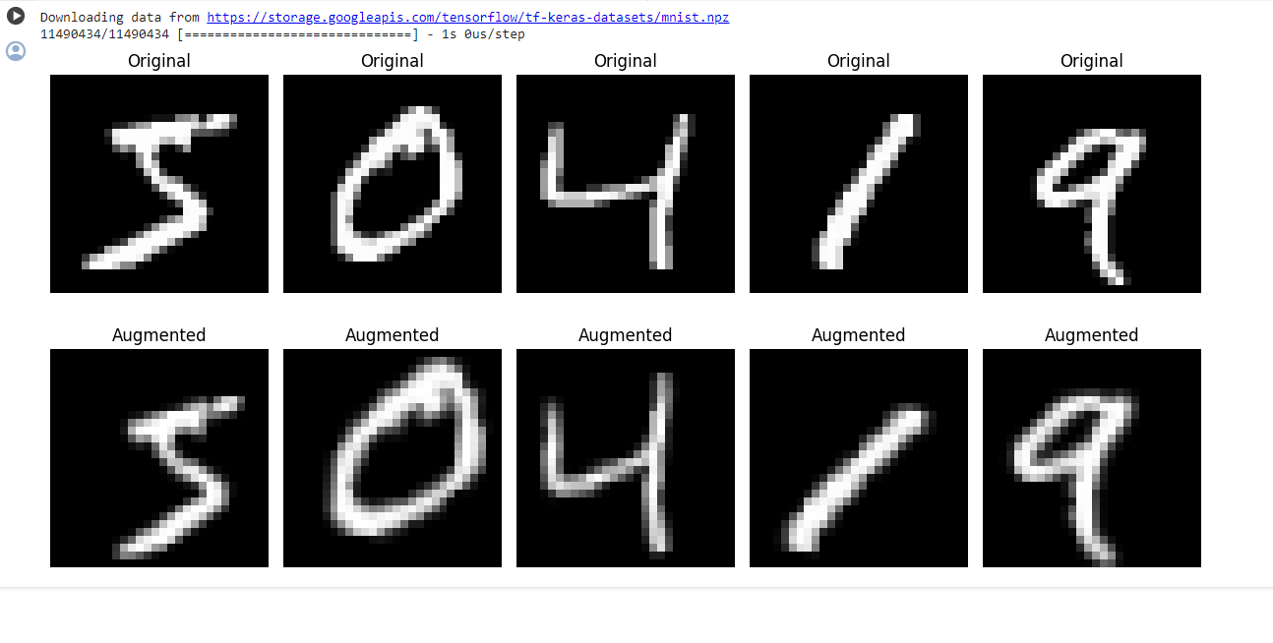
RESULTS
Demo Link
3/21/2024 Annual Review
10

